Slide 1



Semantic Search and
Retrieval-Augmented Generation
Chapter 8

Slide 2


Dense retrieval
Dense retrieval is one of the key types of semantic search, relying on the
similarity of text embeddings to retrieve relevant results.

Slide 3
Rerankers
Rerankers, the second key type of semantic search, take a search query and a collection of results, and reorder them by relevance, often resulting in vastly improved results.
Notes:
Search systems are often pipelines of multiple steps. A reranking language model is one of these steps and is tasked with scoring the relevance of a subset of results
against the query; the order of results is then changed based on these scores. Figure 8-2 shows how rerankers are different from dense retrieval in that they
take an additional input: a set of search results from a previous step in the search pipeline.

Slide 4
RAG
A RAG system formulates an answer to a question and (preferably) cites its information sources.
Notes:
Generative search is a subset of a broader type of category of systems better called RAG systems. These are text generation systems that incorporate search
capabilities to reduce hallucinations, increase factuality, and/or ground the generation model on a specific dataset.

Slide 5
Chunking long texts
It’s possible to create one vector representing an entire document, but it’s better for longer documents to be split into smaller chunks that get their own embeddings.

Slide 6
Multiple vectors per document
Several chunking methods and their effects on the input text. Overlapping chunks can be important to prevent the absence of context.
Notes:
Multiple vectors per document. In this approach, we chunk the document into smaller pieces, and embed those chunks. Our search index then becomes that of chunk
embeddings, not entire document embeddings.

Slide 7
Chunking a document
A number of possible options for chunking a document for embedding.
Notes:
The chunking approach is better because it has full coverage of the text and because the vectors tend to capture individual concepts inside the text. This leads to a more
expressive search index. Figure 8-9 shows a number of possible approaches.
The best way of chunking a long text will depend on the types of texts and queries your system anticipates. Approaches include:
• Each sentence is a chunk. The issue here is this could be too granular and the vectors don’t capture enough of the context.
• Each paragraph is a chunk. This is great if the text is made up of short paragraphs.
Otherwise, it may be that every 3–8 sentences is a chunk.
• Some chunks derive a lot of their meaning from the text around them. So we can incorporate some context via:
—Adding the title of the document to the chunk.
—Adding some of the text before and after them to the chunk. This way, the chunks can overlap so they include some surrounding text that also appears in adjacent chunks. This is what we can see in Figure 8-10.

Slide 8
Retrieval-Augmented Generation (RAG)
A basic RAG pipeline is made up of a search step followed by a grounded generation step where the LLM is prompted with the question and the information retrieved from the search step.
Notes:
RAG systems incorporate search capabilities in addition to generation capabilities. They can be seen as an improvement to generation systems because they reduce
their hallucinations and improve their factuality. They also enable use cases of “chat with my data” that consumers and companies can use to ground an LLM on internal
company data, or a specific data source of interest (e.g., chatting with a book).

Slide 9
RAGS
Find the most relevant information to an input prompt by comparing the
similarities between embeddings. The most relevant information is added to the prompt
before giving it to the LLM.

Slide 10
RAG Evaluation
Fluency: Whether the generated text is fluent and cohesive.
Perceived utility: Whether the generated answer is helpful and informative.
Citation recall: The proportion of generated statements about the external world that are fully
supported by their citations.
Citation precision: The proportion of generated citations that support their associated statements.

Slide 11










TYPES OF AI
NARROW AI
GENERAL AI
SUPER AI
Narrow AI is designed to perform a specific task
General AI can perform any intellectual task that a human can
Super AI is hypothetical and would surpass human intelligence

Slide 12





HISTORY OF AI
The Dartmouth Conference, where the term "artificial intelligence" was first coined and AI was established as a field of research.
1956
The first AI system that could understand and respond to natural language was created by Terry Winograd, which marked a major step forward in natural language processing.
1974
IBM's Deep Blue defeated the world chess champion Garry Kasparov, demonstrating that machines could surpass human intelligence in specific domains.
1997
The emergence of deep learning led to breakthroughs in computer vision, speech recognition, and natural language processing.
2012

Slide 13



IN FINANCE
75%
12,000
50%
people said that AI has improved their decision-making process.
Morgan Chase used AI to analyze 12,000 commercial loan agreements in seconds
The use of AI in fraud detection has led to a 50% reduction in false positives

Slide 14








IN MANUFACTURING
Item 2
Item 3
12
10
8
6
4
2
0
2015
2016
2017
2018
2019
2020
2021

Slide 15








IN TRANSPORTATION
REDUCE 20% FUEL CONSUMPTION
REDUCE 30% MAINTENANCE COSTS
Self-driving trucks powered by AI have been shown to reduce fuel consumption by up to 20%, saving companies thousands of dollars per year.
AI-powered predictive maintenance can reduce maintenance costs by up to 30%, and increase vehicle reliability and uptime.

Slide 16






03
SOCIAL IMPLICATIONS
Explores the broader impact of AI beyond specific industries or applications. Considers ethical and societal implications such as job displacement, bias, privacy concerns, and potential impacts on democracy and human rights. Encourages a critical and thoughtful approach to AI development and deployment, taking into account the potential risks and benefits to individuals and society as a whole.

Slide 17




AI AND JOBS
JOBS AT HIGH RISK
JOBS AT SIGNIFICANT RISK
14%
32%

Slide 18



AI ETHICS
81%
People believe that companies should prioritize ethical considerations
63%
Were concerned about the ethical implications of the AI system

Slide 19
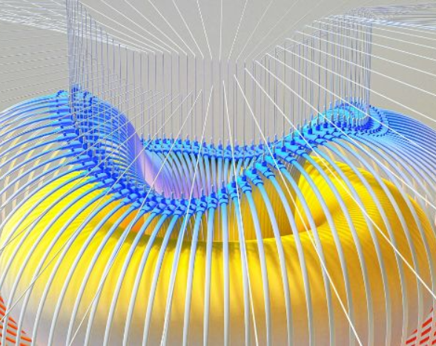

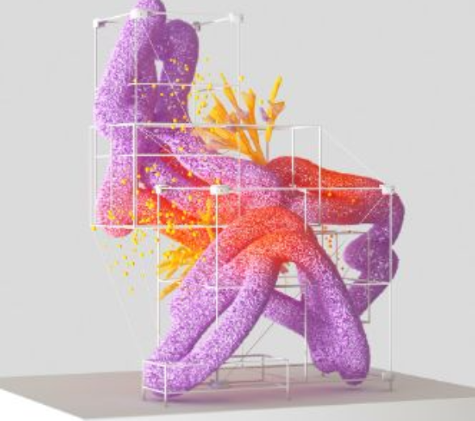

AI AND PRIVACY
A survey by Pew Research Center found that 64% of Americans are concerned about the way that companies are using their data, and 81% feel that they have little or no control over the data that companies collect about them.
20%
55%
The EU's GDPR includes provisions for ensuring that individuals have the right to access and control their personal data, including data that is processed using AI systems.

Slide 20



AI AND SOCIETY
Discusses the broader societal implications of AI, including its impact on job displacement, inequality, and social norms. This section aims to provide a comprehensive understanding of the ways in which AI is shaping our society and the challenges that need to be addressed.
04

Slide 21


THE RISE OF POWERFUL AI WILL BE EITHER THE BEST OR THE WORST THING EVER TO HAPPEN TO HUMANITY. WE DO NOT YET KNOW WHICH.
STEPHEN HAWKING

Slide 22








THANK YOU FOR
CHOOSING EATEMP
We offer free and high-quality slides templates for your presentations. We appreciate you choosing us and hope our templates have been helpful.
As a new website, we rely on your support to grow, so please help us by sharing our site with your friends and colleagues.
eatemp._
@eatemp
eatempofficial
@eatemp.official

